Slide 1


T-HTN: Timeline-Based HTN Planning for Multiple Robots
ICAPS Hierarchical Planning Workshop (HPlan) 2022
Viraj Parimi, Zachary B. Rubinstein, Stephen F. Smith
June 13th, 2022
Carnegie Mellon
Notes:
Hi everyone, I am Viraj and I am going to present our planning framework called T-HTN which is a timeline-based HTN planning framework for multiple robots.

Slide 2
Motivation
Multi-Robot Planning Problems
Goal assignment
Spatio-Temporal constraints
Durational uncertainty
Reactive
Notes:
Effective coordinated actions by a team of robots operating in close proximity to one another is an important requirement in many emerging applications especially in the maintenance of deep space habitats during unmanned periods. Yet, such multi-robot planning problems remain a significant challenge for contemporary planning technologies, due to several complicating factors which include situations where the
goals must be assigned to robots and accomplished over time in the
presence of complex temporal and spatial constraints in a manner that optimizes overall team performance.
Additionally, attention must be given to the durational uncertainty inherent in robotic task execution,
and planning must be responsive to changing and unexpected execution circumstances.

Slide 3
Previous Approaches
What is lacking?
Action-based planners (PDDL-style and HTN-style)
Forward state-space search
Awkward for satisfying temporal constraints
Timeline-based planners
Opportunistic insertion via STNs
Use hand-crafted, domain specific heuristics
Notes:
On one hand,
heuristic, action-based temporal planners, both PDDL-style and HTN-style, typically achieve tractability by constraining the plan generation process
to forward state-space search i.e., expanding plans in a strict time-forward order.
This assumption can be quite awkward for satisfying certain types of temporal constraints like task deadlines, and more generally can be quite limiting with respect to optimizing team performance objectives across a set of goals.
On the other hand, timeline-based planners provide a flexible,
Simple Temporal Network based infrastructure that allows planning actions to be inserted opportunistically at various time points across an agent’s planning horizon during plan generation so as to better optimize global properties of the plan such as its makespan.
But timeline-based systems lack general principles for global search control, and tend to be driven by use of hand-crafted, domain specific heuristics that do not transfer easily to new problems.

Slide 4
Approach
Combine!
Structural power of HTN representation
Expressivity and flexibility of Timeline-Based planning frameworks
Efficiency of goal regression and resource allocation perspective
Notes:
To overcome the inefficiency and idiosyncrasy of reasoning about actions at the individual component level, T-HTN couples timeline-based reasoning with an HTN planning model designed for resource allocation. By doing this we are able to combine the
structural power of the HTN representation
with the expressivity and flexibility of timeline-based planning frameworks
from a goal regression and resource allocation perspective. By introducing hierarchical structure that organizes task decomposition around allocation of resources to tasks and placement of their constituent actions on resource timelines, T-HTN is able to achieve both search efficiency and flexibility, while retaining the representational expressiveness and generality of state-of-the-art temporal planning frameworks.

Slide 5



Methodology
Example Scenario
Block A
Block B
Block C
Block D
Block E
Notes:
For the purpose of explaining our approach, consider two UR5 robotic arm manipulators mounted on shared railway network who are tasked to
move the box from its initial location to a target location within a specified deadline. This scenario will act as a running example.

Slide 6
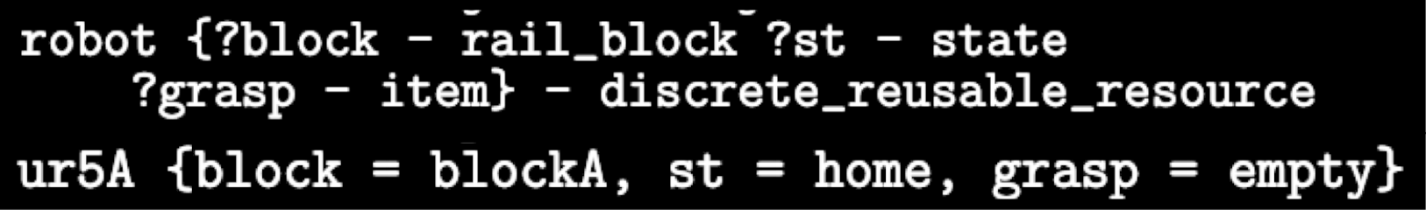
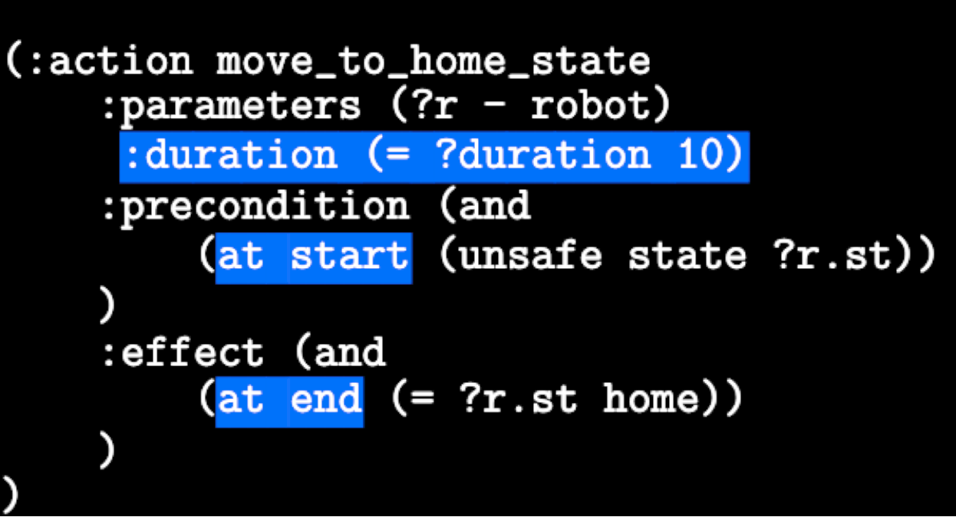
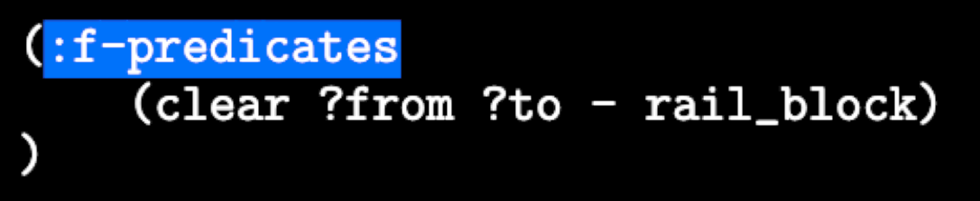
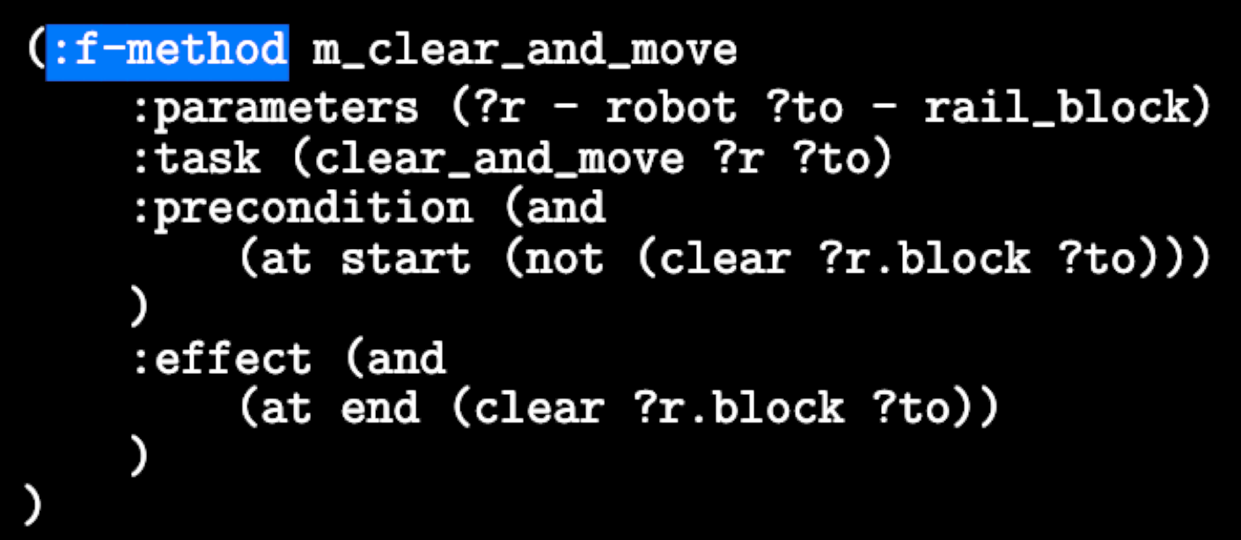
Methodology
Language Extensions
Objects with attributes
Temporal constraints
Functional predicates and methods
Notes:
To allow for specifying additional resource structure that T-HTN leverages, we extend HDDL for representing the domain and problem inputs.
Specifically we added support for objects with attributes where robot is a resource type and supports rail block, state and grasped item attributes.
Further, we added support for temporal constraints and
two additional constructs called functional predicates and methods that allows for the use of specialized algorithms for handling specific planning sub-problems efficiently

Slide 7







Methodology
Core Search Procedure
Bind Parameters
Instantiate Task Network
Find Slots
Path Decomposition
Tree
Commit
T-HTN Planner
Incoming Request
Output Plan
Notes:
Given the domain representation, we now present our framework’s comprehensive plan generation search procedure.
The algorithm has multiple steps. The first step towards generating a feasible plan is to process the incoming request
and map it to a known task model to create a path decomposition tree of all the potential possible alternatives.
Once the path decomposition tree is generated, the next step is to enumerate all the possible alternative decompositions. For each such decomposition, a task network is instantiated that is tied with an underlying STN, and composed of the tokens that correspond to the high-level tasks or action primitives.
This task network forms the fundamental structure with which we first ground the unassigned variables and
then utilize it to search for “slots” on the required resource timelines where the instantiated tokens can then be feasibly inserted.
This process is then repeated for all the other alternative decompositions enumerated via the path decomposition tree.
Finally, once all options have been generated, they are evaluated according to some set of objective criteria like minimizing overall task makespan or completing the task as early as possible, after which, we commit to the best option
and output the plan.
The blue nodes correspond to the input and output of our framework’s planner whereas the red nodes correspond to the actual plan generation search procedure itself.

Slide 8
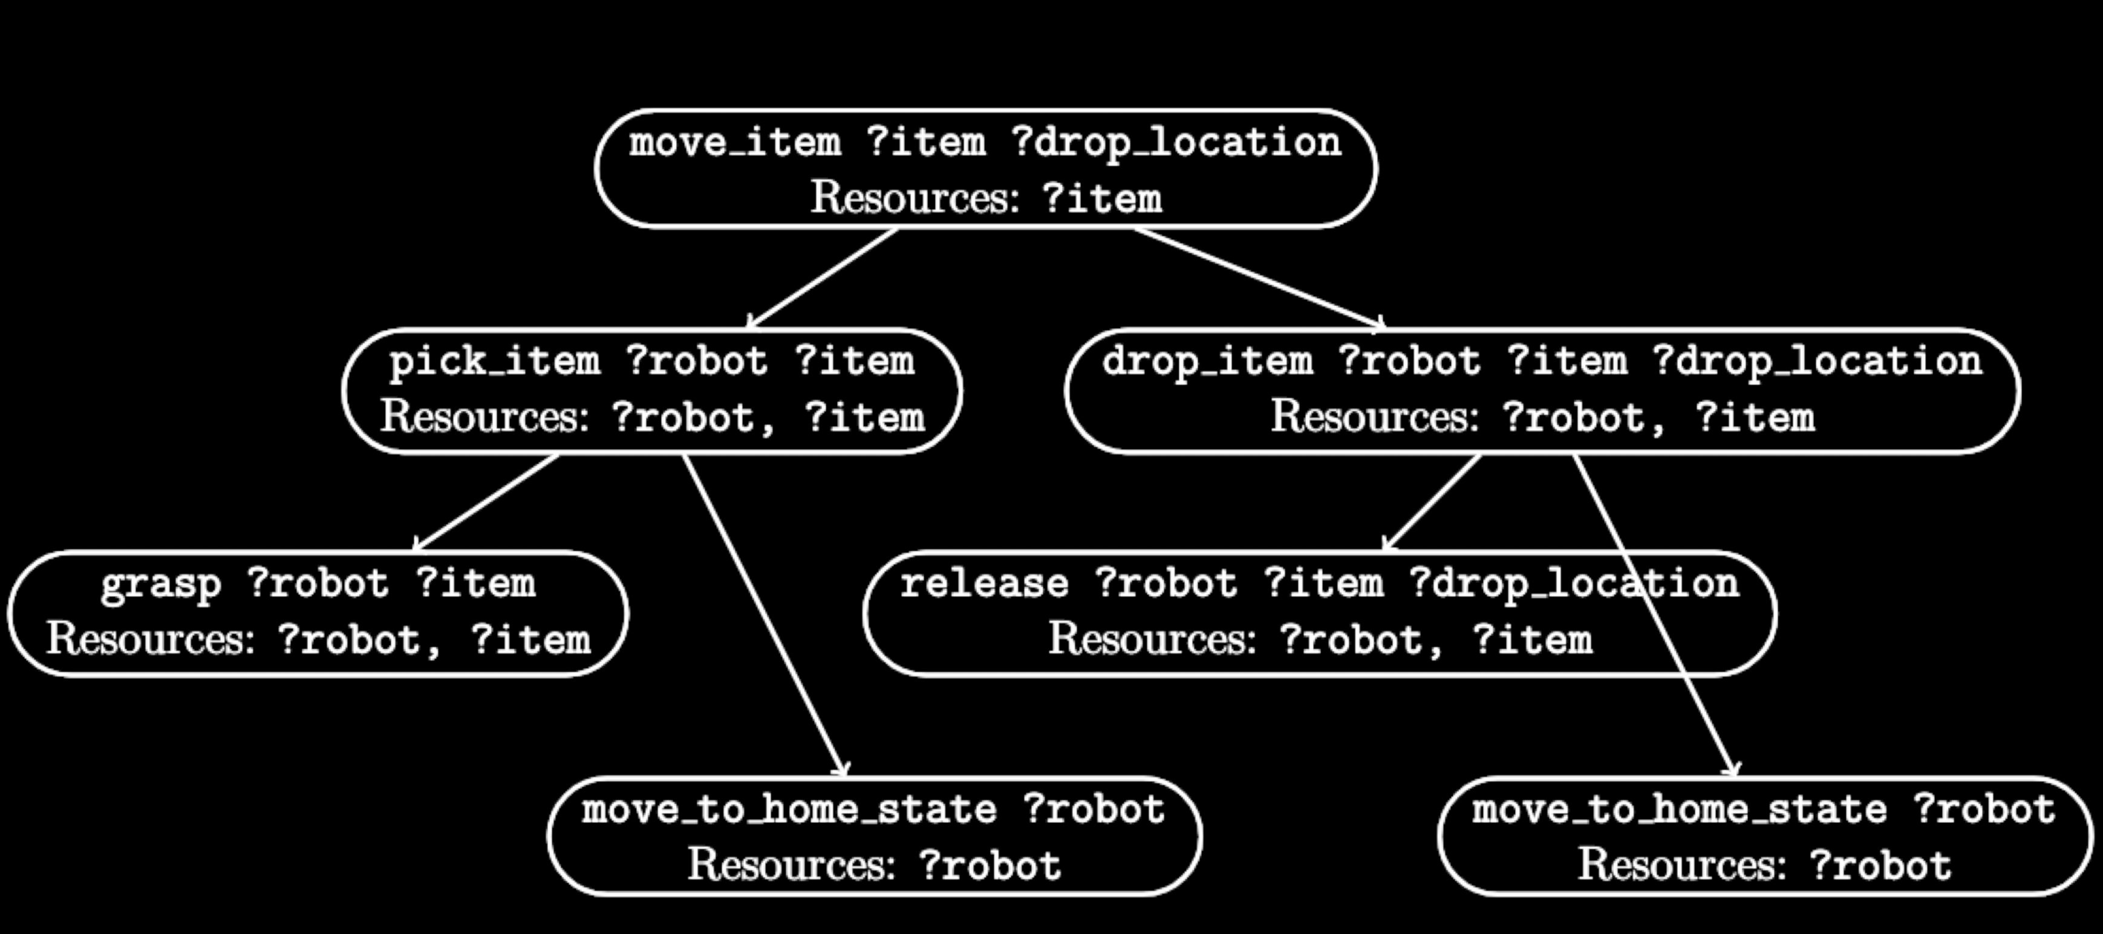
Methodology
Enumerate Decompositions
Notes:
To generate the path decomposition tree, a variant of the AND/OR tree is built where each internal node within the tree represents either an OR node for the higher-level parent task while the leaves represent the action primitives. Based on our example scenario, we generated the following path decomposition tree.

Slide 9
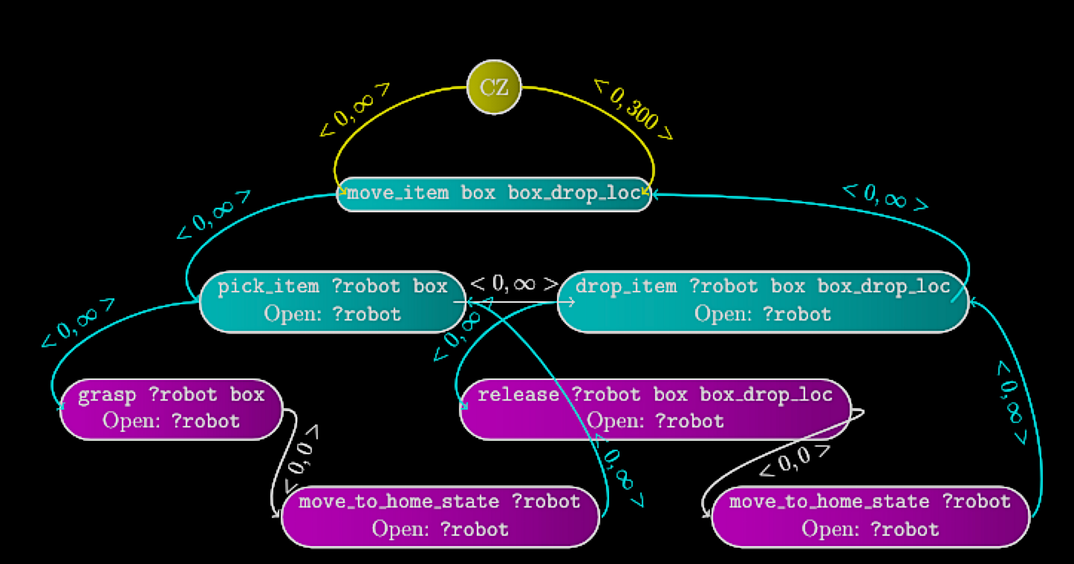
Methodology
Instantiate Task Network
Notes:
For each possible alternative decomposition in turn, we instantiate a task network that is tied with the underlying STN and contains tokens corresponding to constituent tasks and actions.
Here, nodes in blue represent the high-level tasks, and the nodes in pink represent the action primitives. The yellow edges correspond to the release time and due date constraints, while the blue edges correspond to the contains constraint. The white edges correspond to the pre- specified synchronization rules.

Slide 10
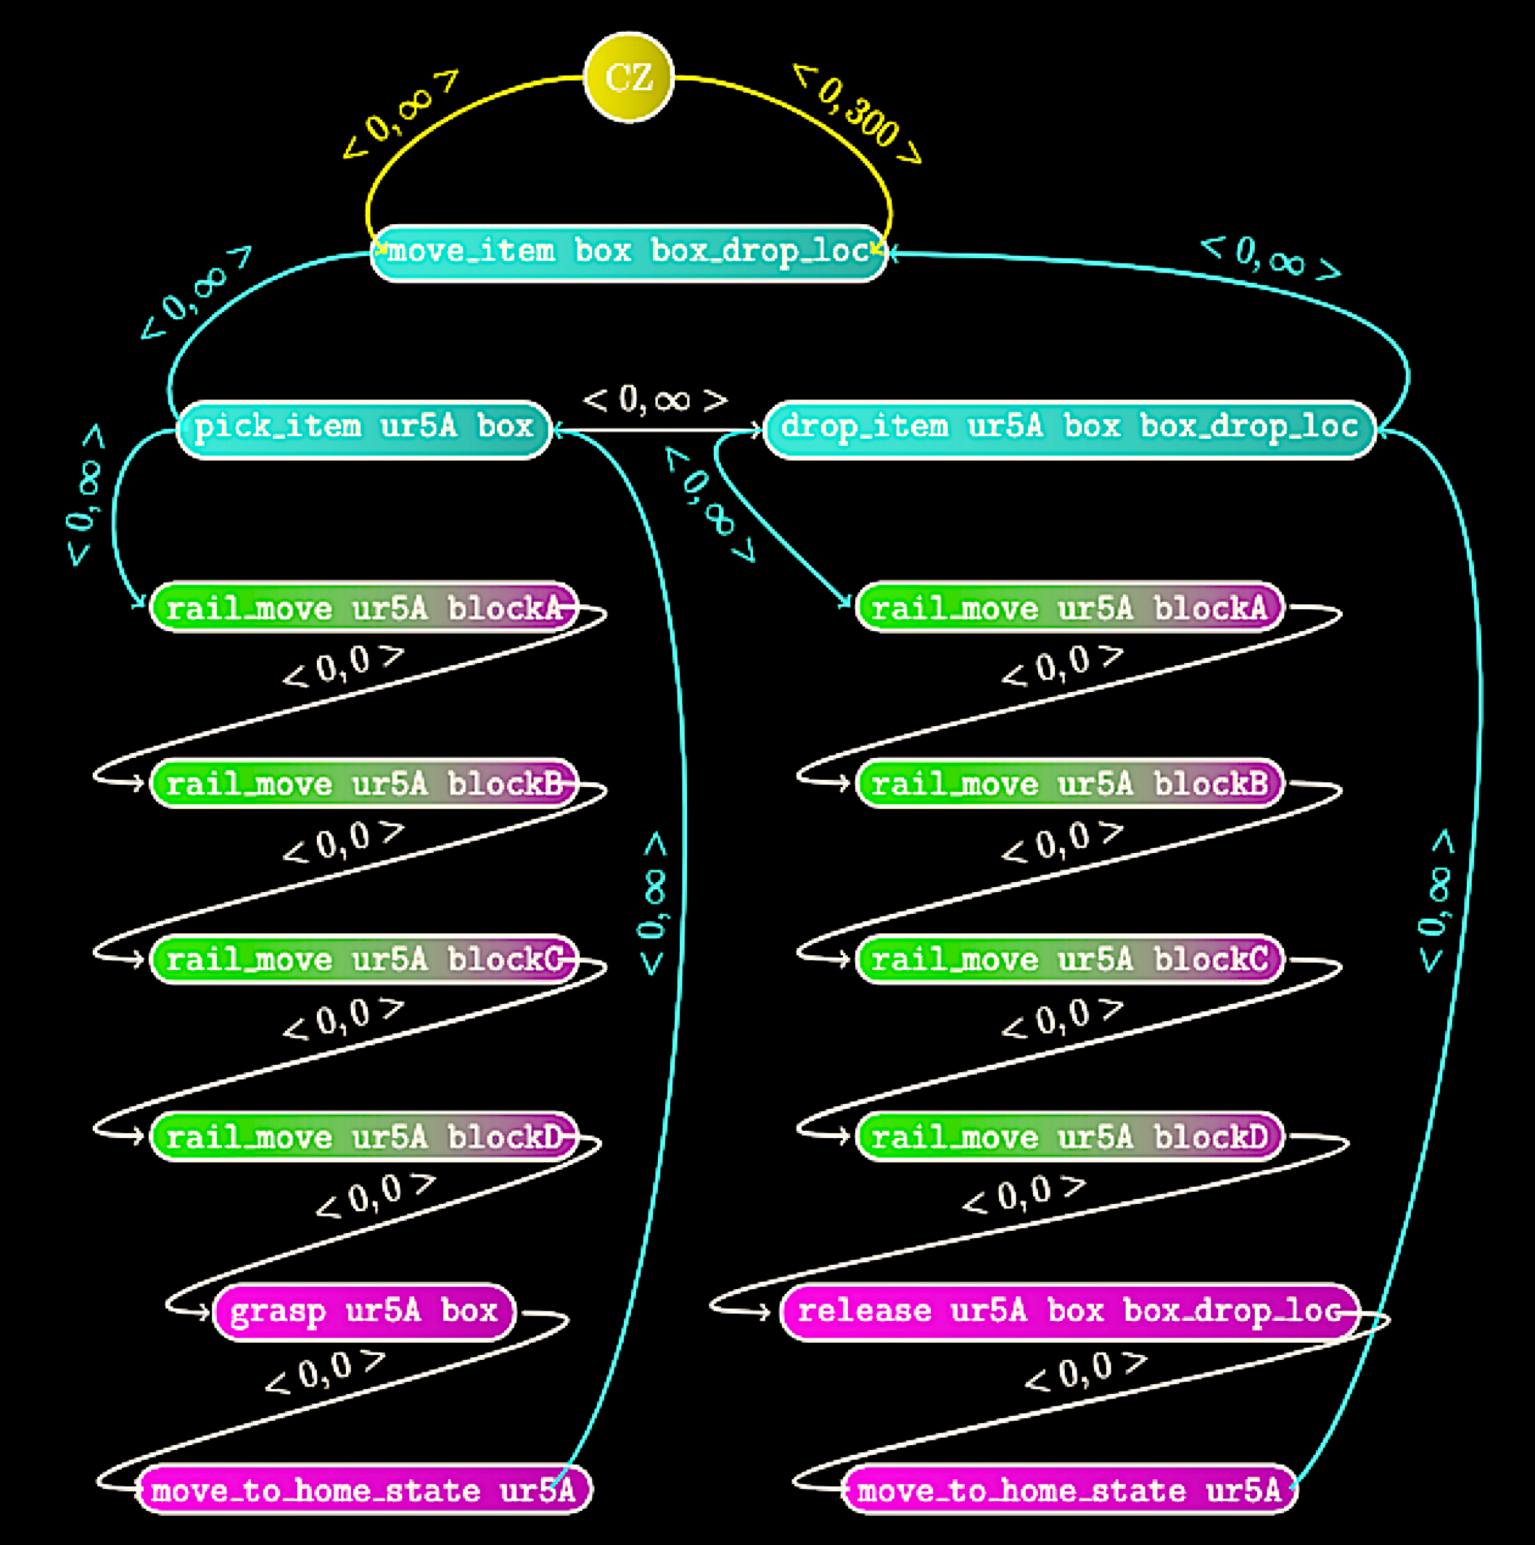


Methodology
Bind Parameters
Block A
Block B
Block C
Block D
Block E
Notes:
Looking back at the example domain,
assuming the left robot was tasked to grasp the box, then it is clear to observe that the other robot must move out of the way for the actions to take place successfully. This means that when the proposed framework tries to schedule the instantiated task network with the left robot as the robot parameter assignment, it triggers a
call to a functional method we saw earlier. This method is internally tied to a specialized external planner that computes the path for the offending robot to move out of the way of a given path for the calling robot.
As a result the functional method outputs a set of corresponding rail moves that are reflected in the updated task network.

Slide 11
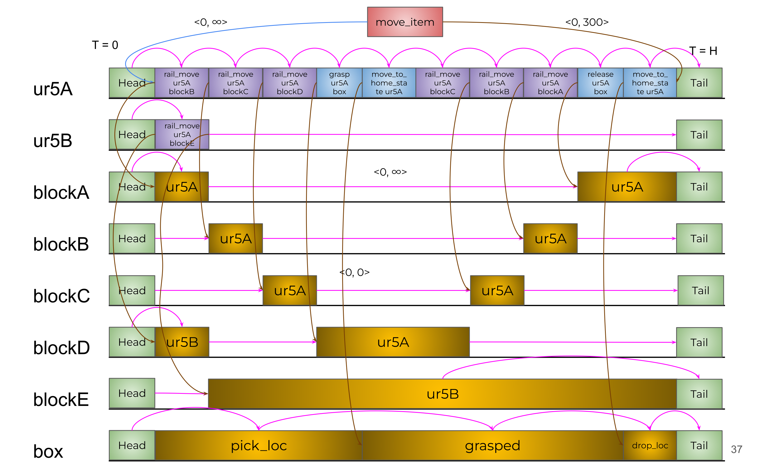



Methodology
Find Slots
Target
Token 1
Token 2
Token 3
Notes:
Once the fully instantiated task network is built, we determine the set of feasible slots by a backward timeline scanning process that repeatedly attempts to backward schedule the action tokens in the instantiated task network at each possible start point. The timeline scanning process iterates through all required resource timelines in reverse order,
1.
2.
3.
identifying sequential pairs of tokens currently on the timeline that delineate potential slots. The search of slots pivots around resources of type robot, while considering other required resources like rail blocks as dependent resources. Preconditions on actions are checked against different possible states within the slot.
Applying the whole plan generation search procedure as described, we present the final snapshot of the generated plan by our framework in response to scheduling the example domain discussed earlier from the timelines perspective.

Slide 12
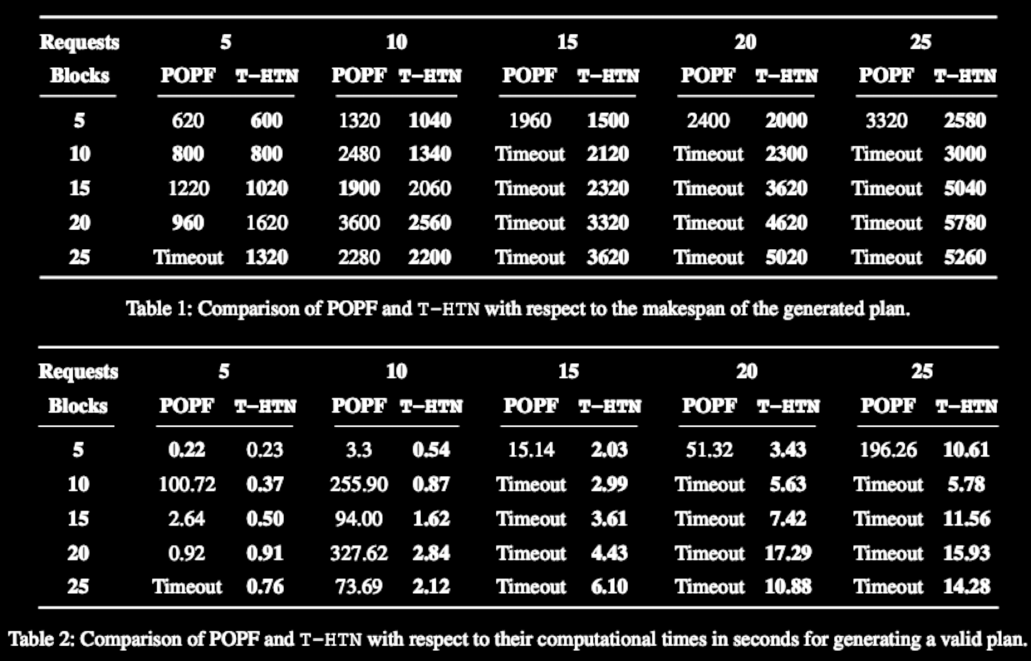
Experimental Results
Vs POPF
Better makespan results for 92% of experiments
100% solution rate compared to 52% due to timeouts
Upto 3 orders of magnitude faster!
Notes:
To evaluate the potential of the T-HTN framework, we compare its performance to POPF. The experiments vary in the number of rail blocks, increasing the number of resources that must be managed, and the number of requests, which increases the size of the overall plan. A time limit of 10 minutes was imposed for solution of any problem instance.
From the results we see that, T-HTN is able to generate plans with better makespan for 92% of the problem instances with upto 2 times improvement.
Further, T-HTN was able to successfully find valid plans for all experimental scenarios whereas POPF was not able to find solutions to 48% of them due to timeout.
Significantly, we were able to generate valid plans with upto 3 orders of magnitude speedup.

Slide 13
Takeaways
Structural advantage of HTNs
Expressiveness of timeline-based planning
Decision-making via resource allocation
Notes:
Finally, to summarize we have presented T-HTN, a multi-robot planning framework that combines the
structural advantages of an HTN representation with the
expressiveness and flexibility of timeline-based planning frameworks.
We have argued that by emphasizing resource allocation as the basic decision-making focus, it is possible to overcome the complexity of the resulting expanded search space and efficiently produce high quality multi-agent plans.

Slide 14
Thank you!
Notes:
Thank you!

